Slide 1

PROJECT INTRODUCTION
Project Overview:
A Flutter-based Web Platform that utilizes node-centric, intuitive UI that allows users to create and deploy personalised AI Agents by dragging and dropping elements on a canvas, without the need of any prior technical knowledge.
Project Objectives:
To streamline the complex process of creating personalised AI Agents by executing complex operations and Autogen AI scripts on server side, while presenting the user with a straightforward and intuitive interface
SUMMER HACK

Slide 2
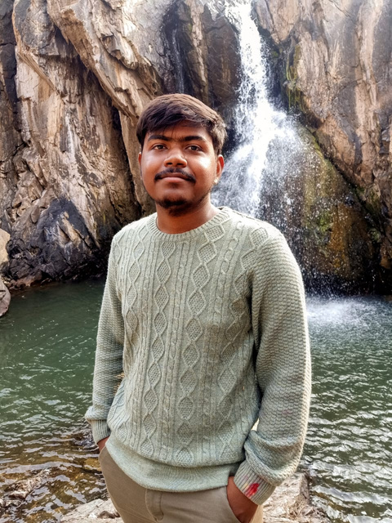
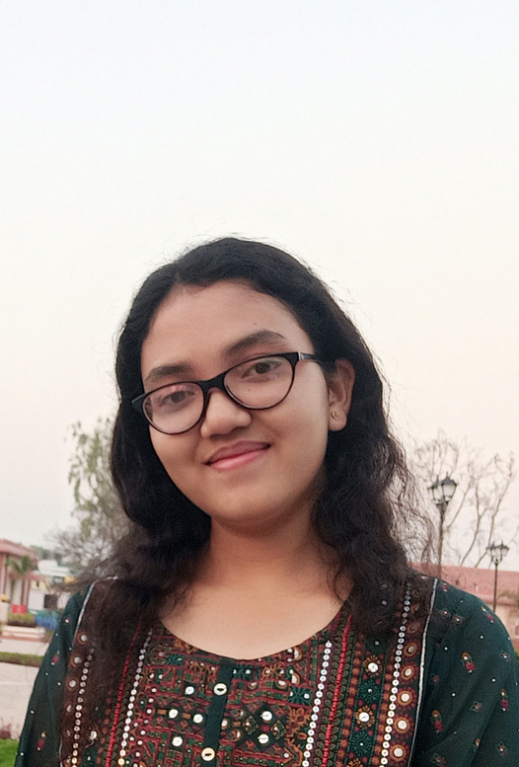
TEAM MEMBERS:
ANKUSH BEHERA
LIPIKA MUNDA
AI ML and Frontend developer
Ui designer and Backend developer
SUMMER HACK

Slide 3
PROBLEM STATEMENT:
To build a a user-friendly, no-code playground for anyone to deploy and chat with AI agents.
SUMMER HACK

Slide 4
TECH STACK :
Frontend: Flutter
Backend: Flask, SQLAlchemy
AI: Autogen Framework
Cloud: Google Cloud Platform
SUMMER HACK

Slide 5
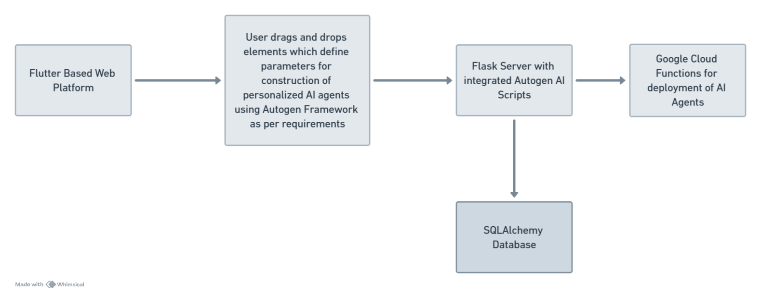
BLUEPRINT OF THE TOOL:
SUMMER HACK

